Slide 1
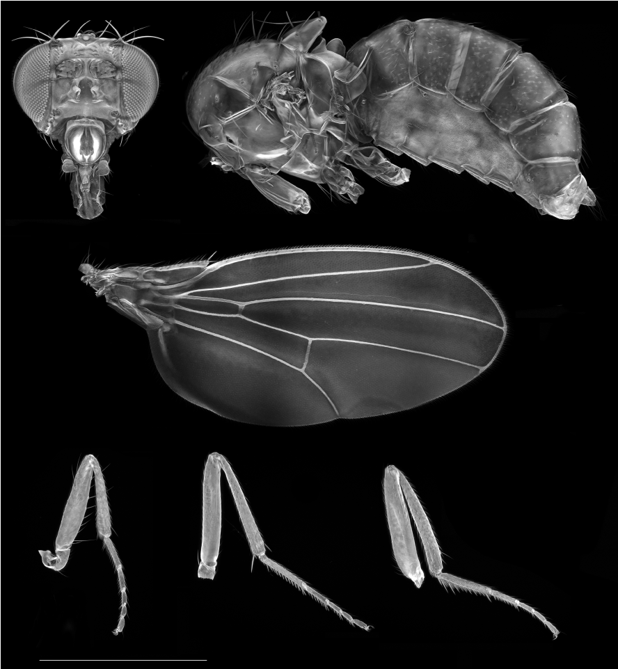
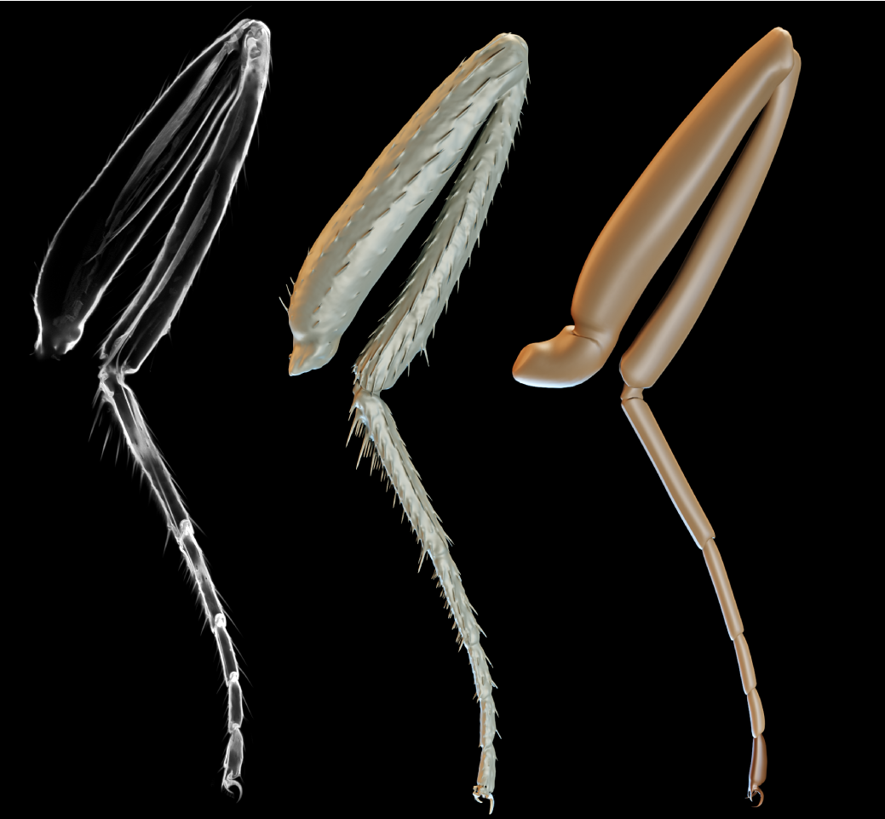
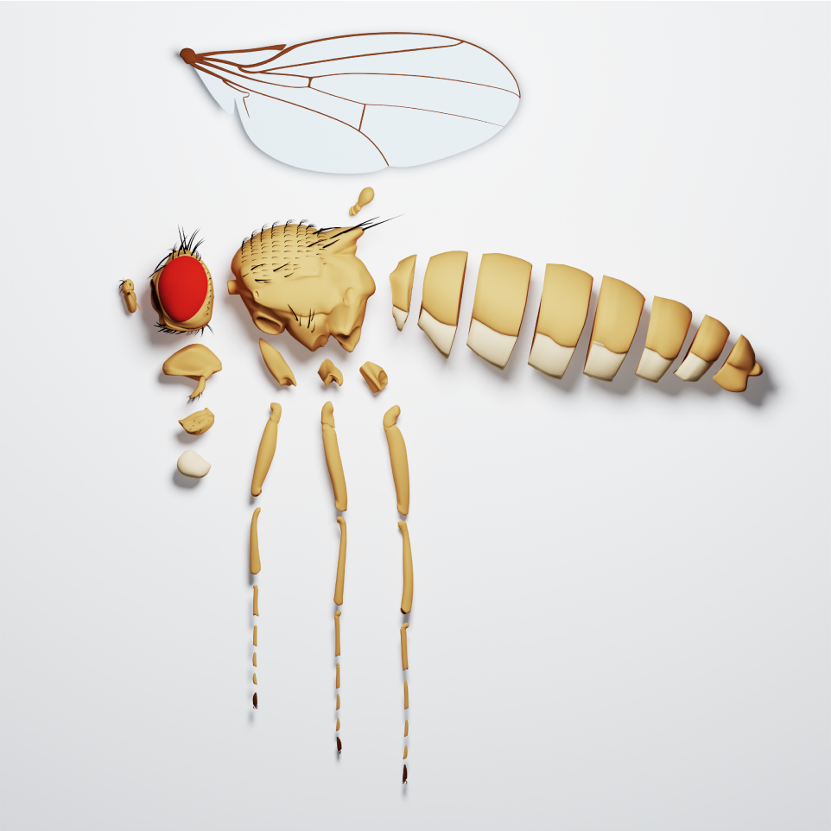
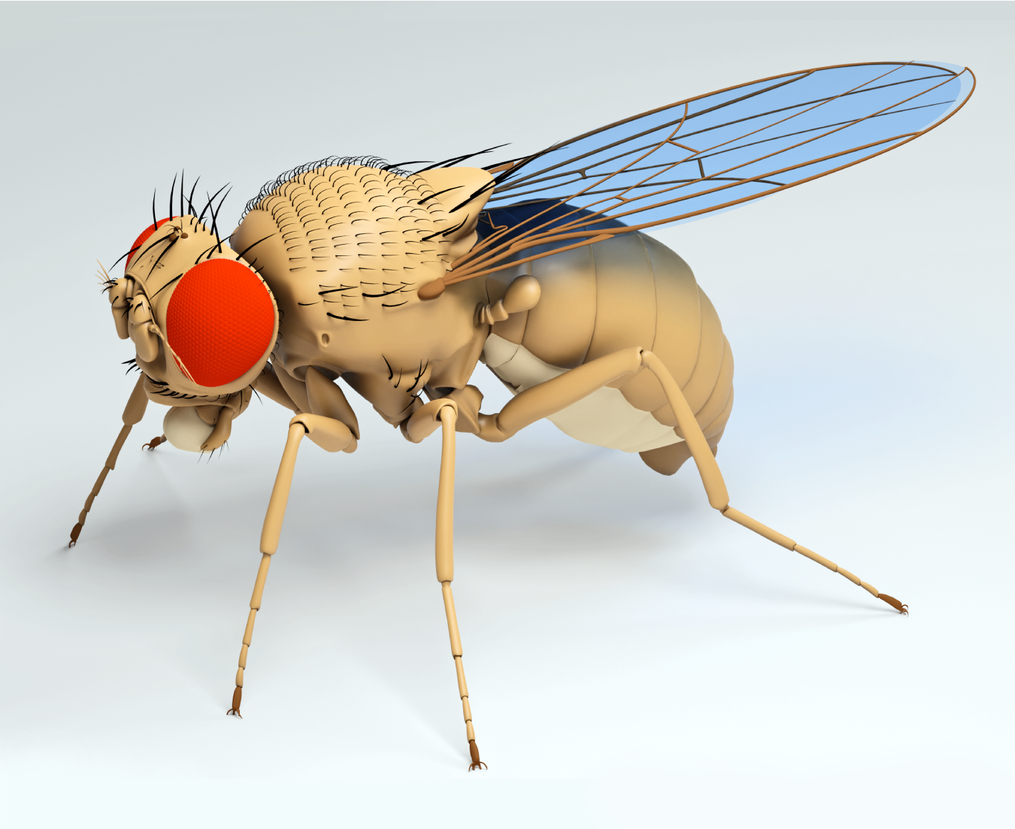
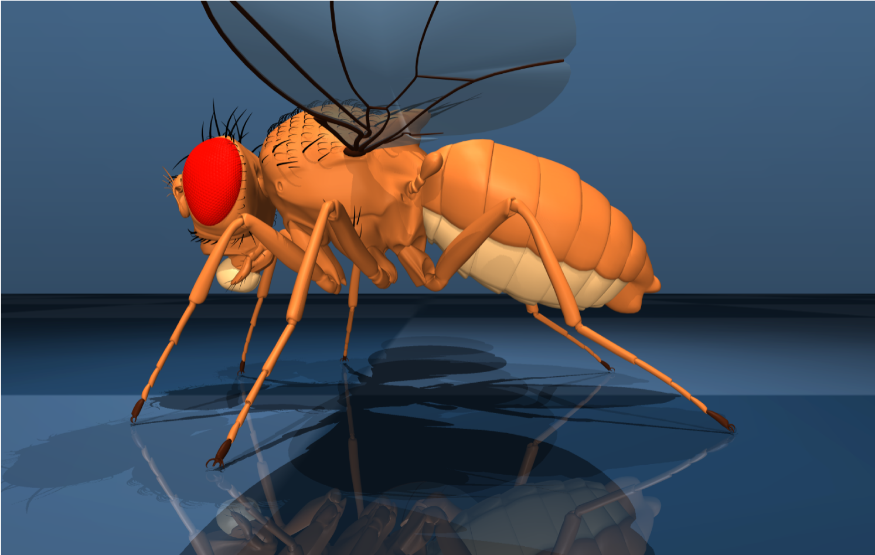
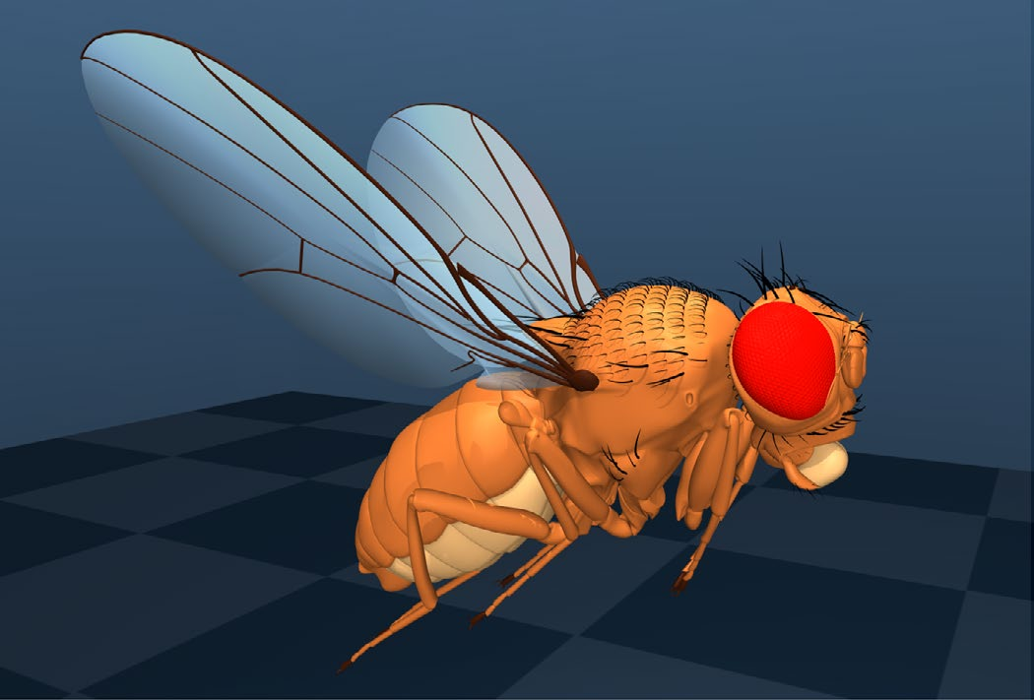
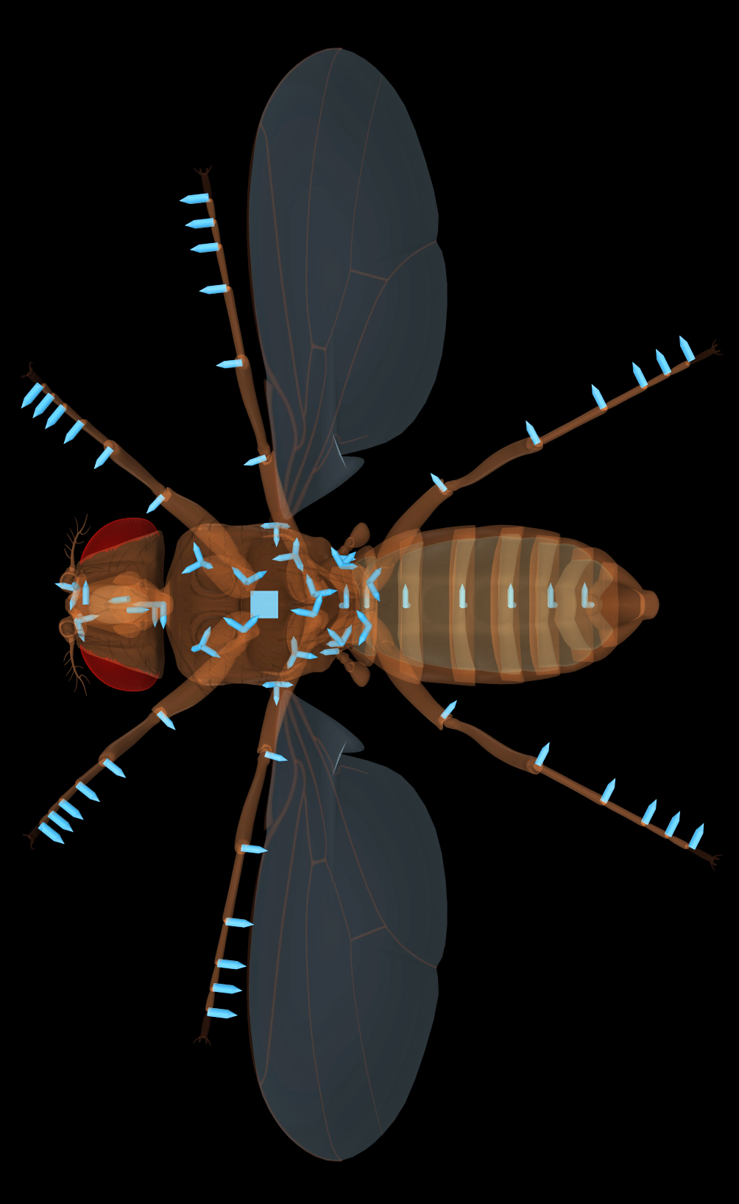
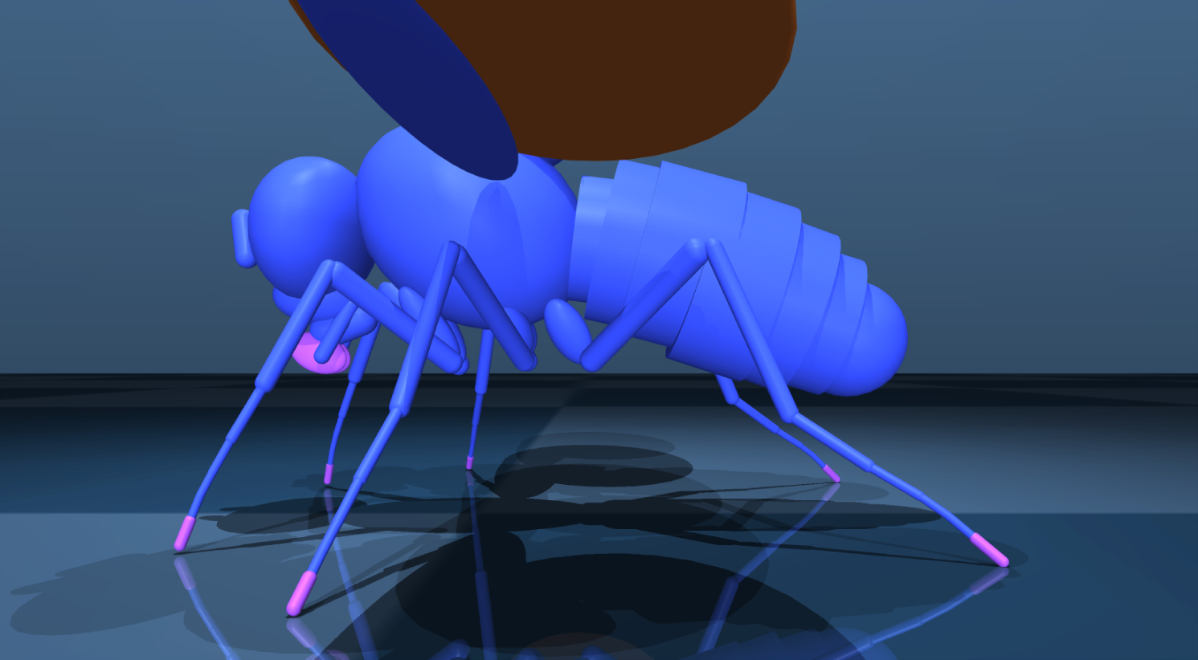
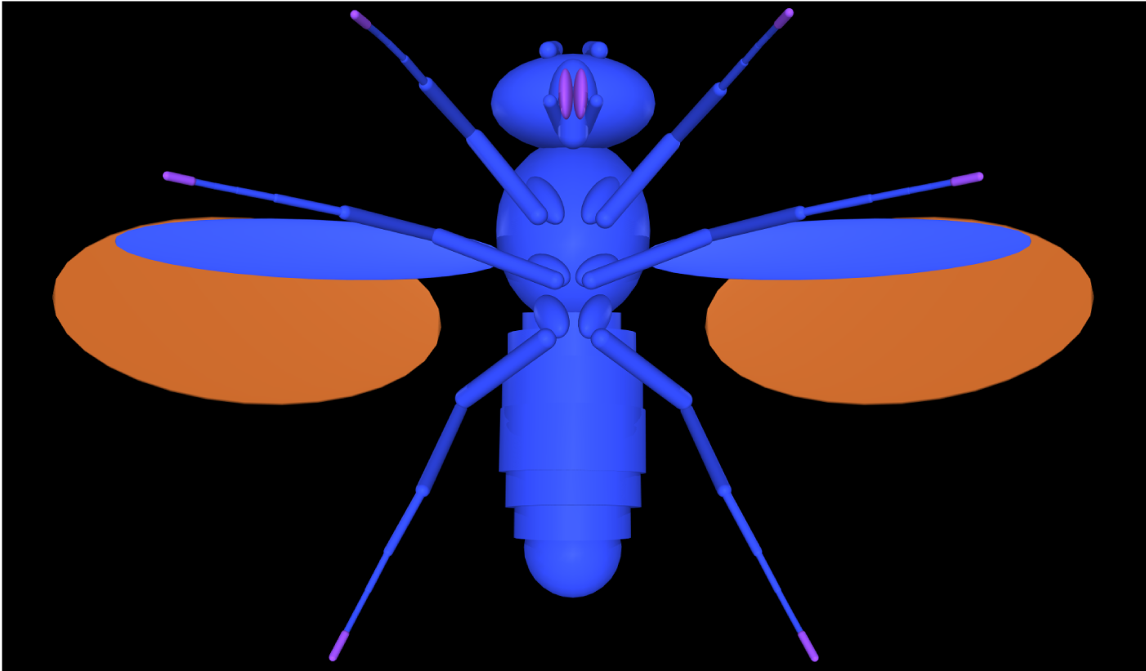
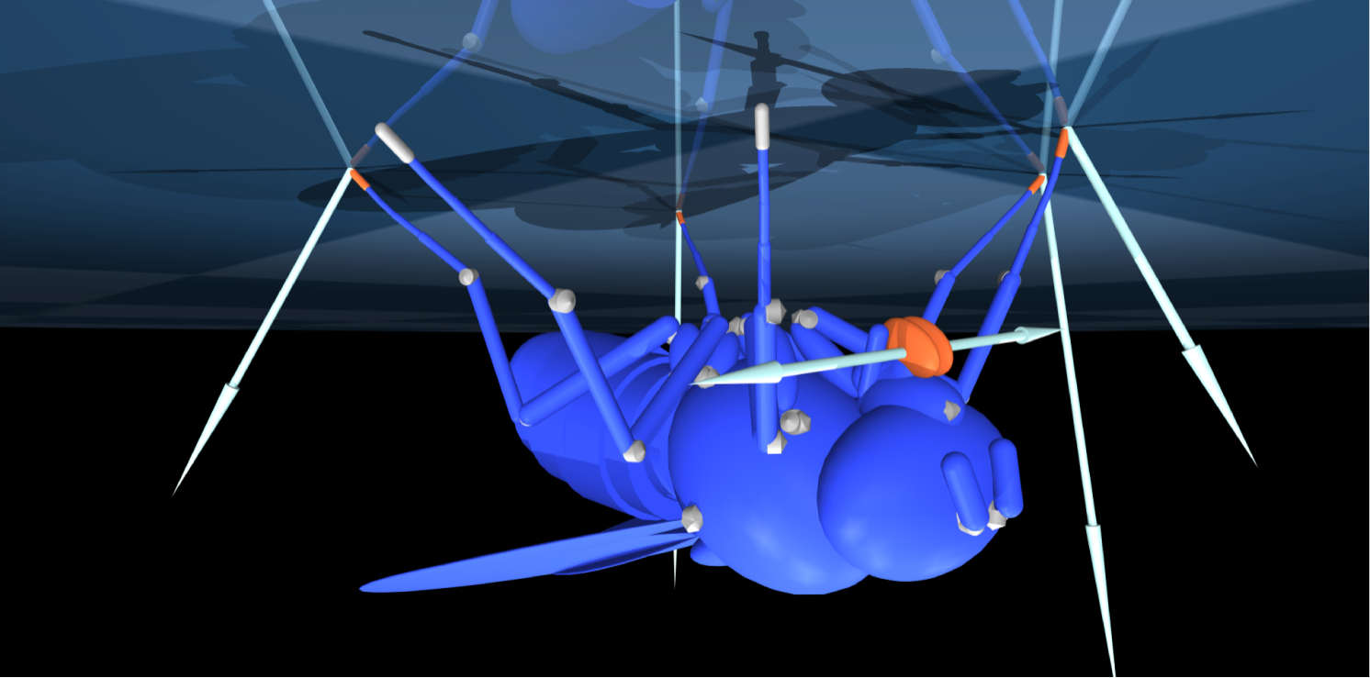
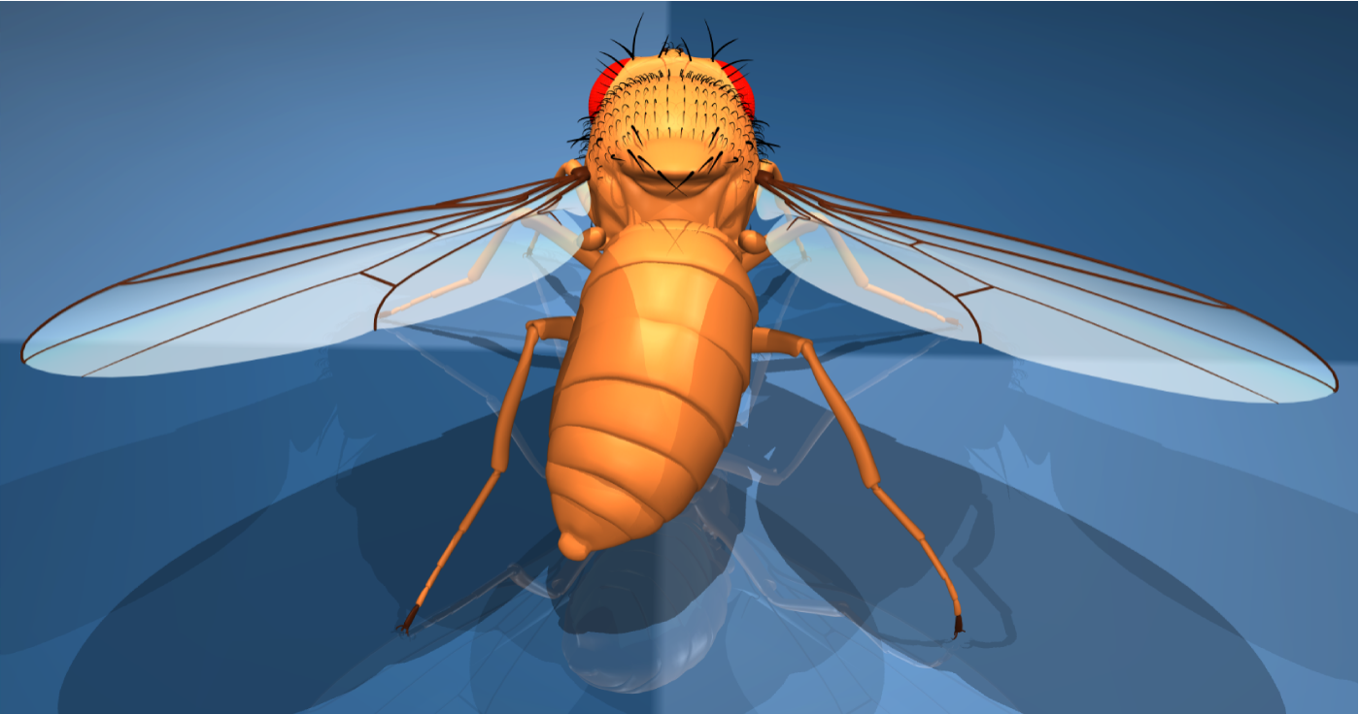
a
b
c
Notes:
fig_1.pdf
Walking

Slide 2
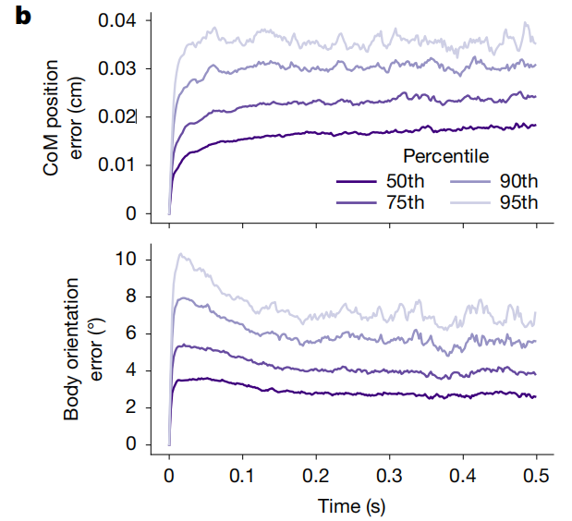
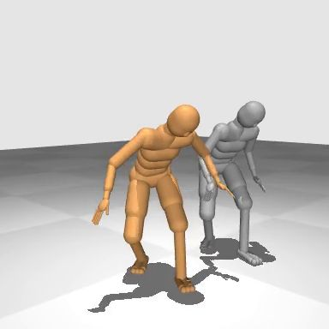
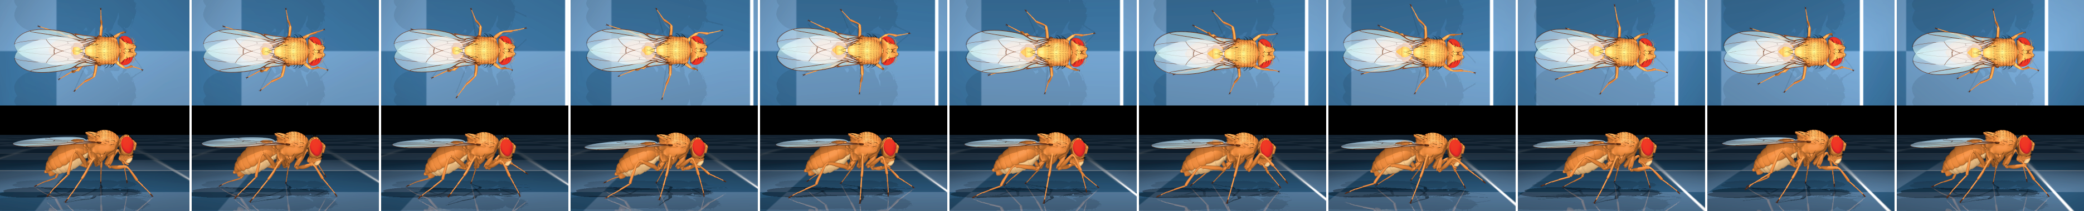
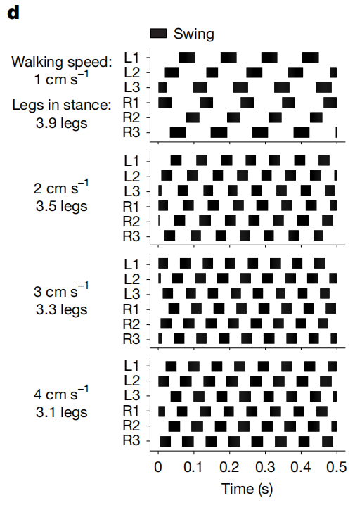
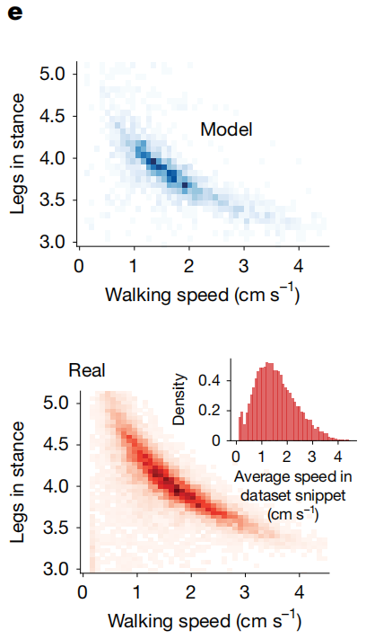
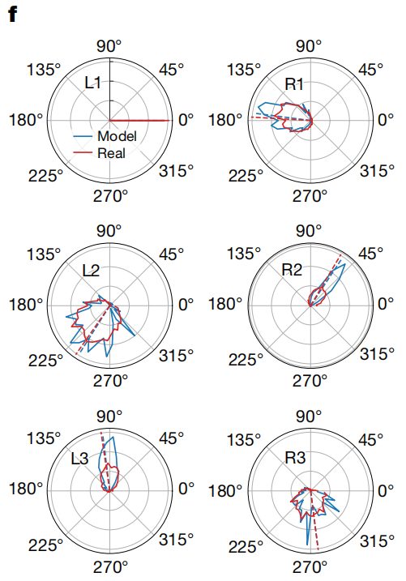
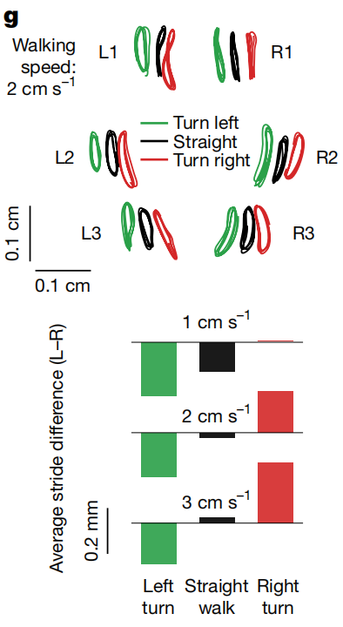
a
Observations:
Sensory input
Steering command
Reward for imitating real walking trajectories::
Track CoM position
Track body orientation
Track leg movements
Pretrained
low-level
controller
Actions command
to actuators
Human Walking model in MuJoCo
physics simulator
c
Notes:
fig_2.pdf
Walking

Slide 3
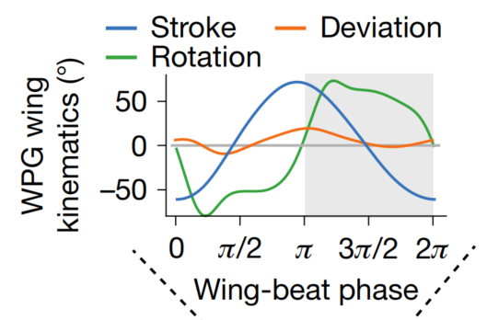
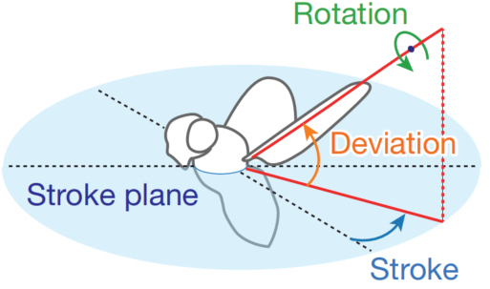
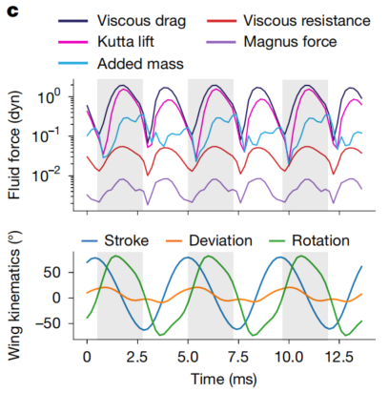
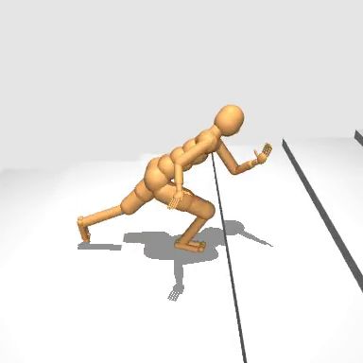
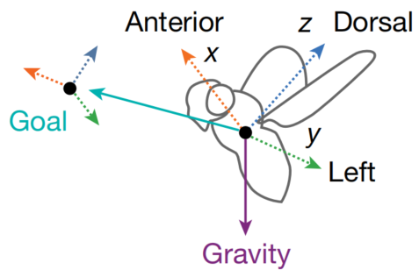

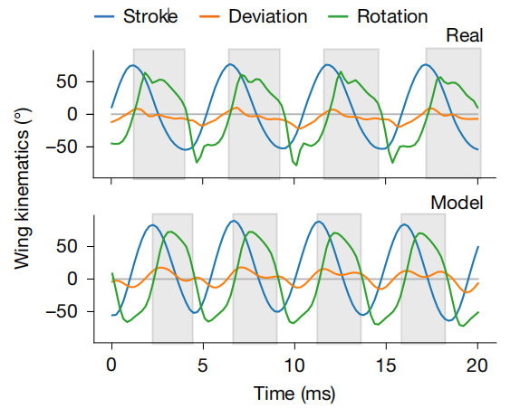
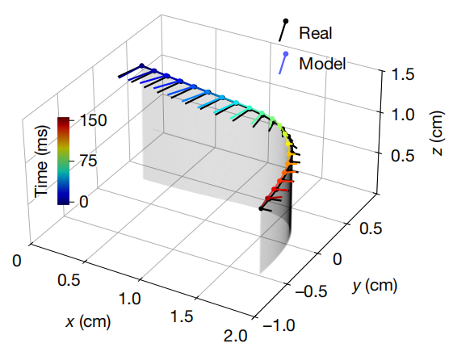
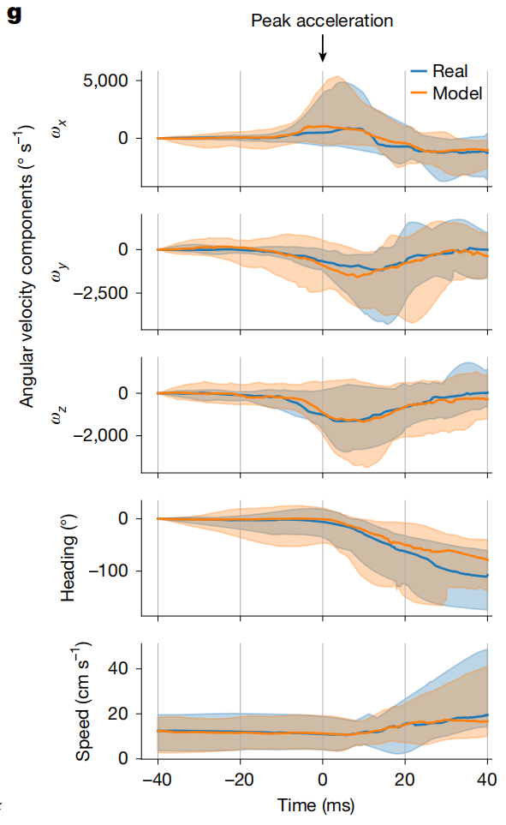
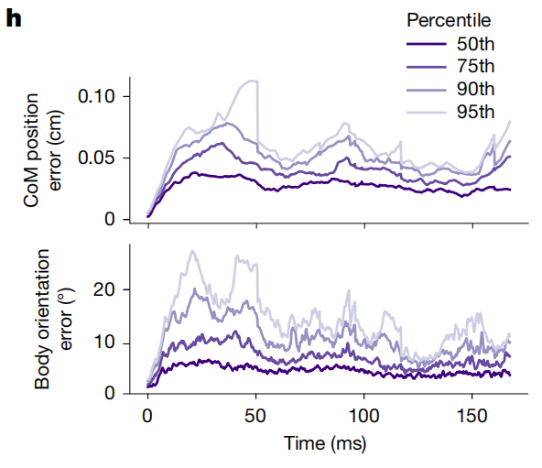
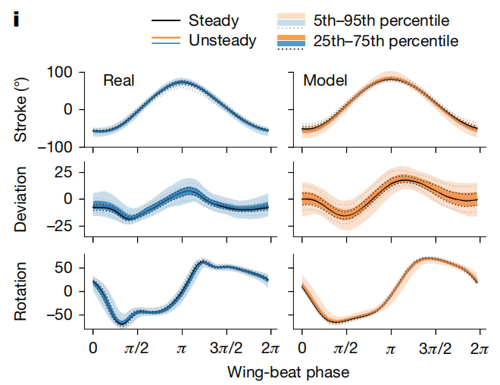
a
Observations:
Sensory input
Steering command
b
Pretrained
low-level
controller
Leg frequency
control
LPG
Reward for imitating real running trajectories::
Track CoM position
Track body orientation
Actions command
to actuators
Human running model in MuJoCo
physics simulator
d
e
f
Notes:
fig_3.pdf
Leg Patten Generator (LPG)

Slide 4
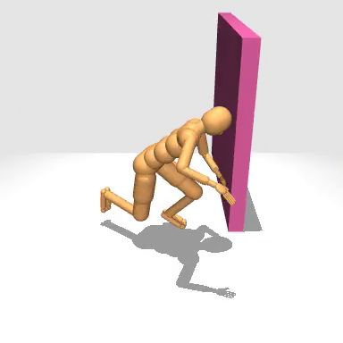
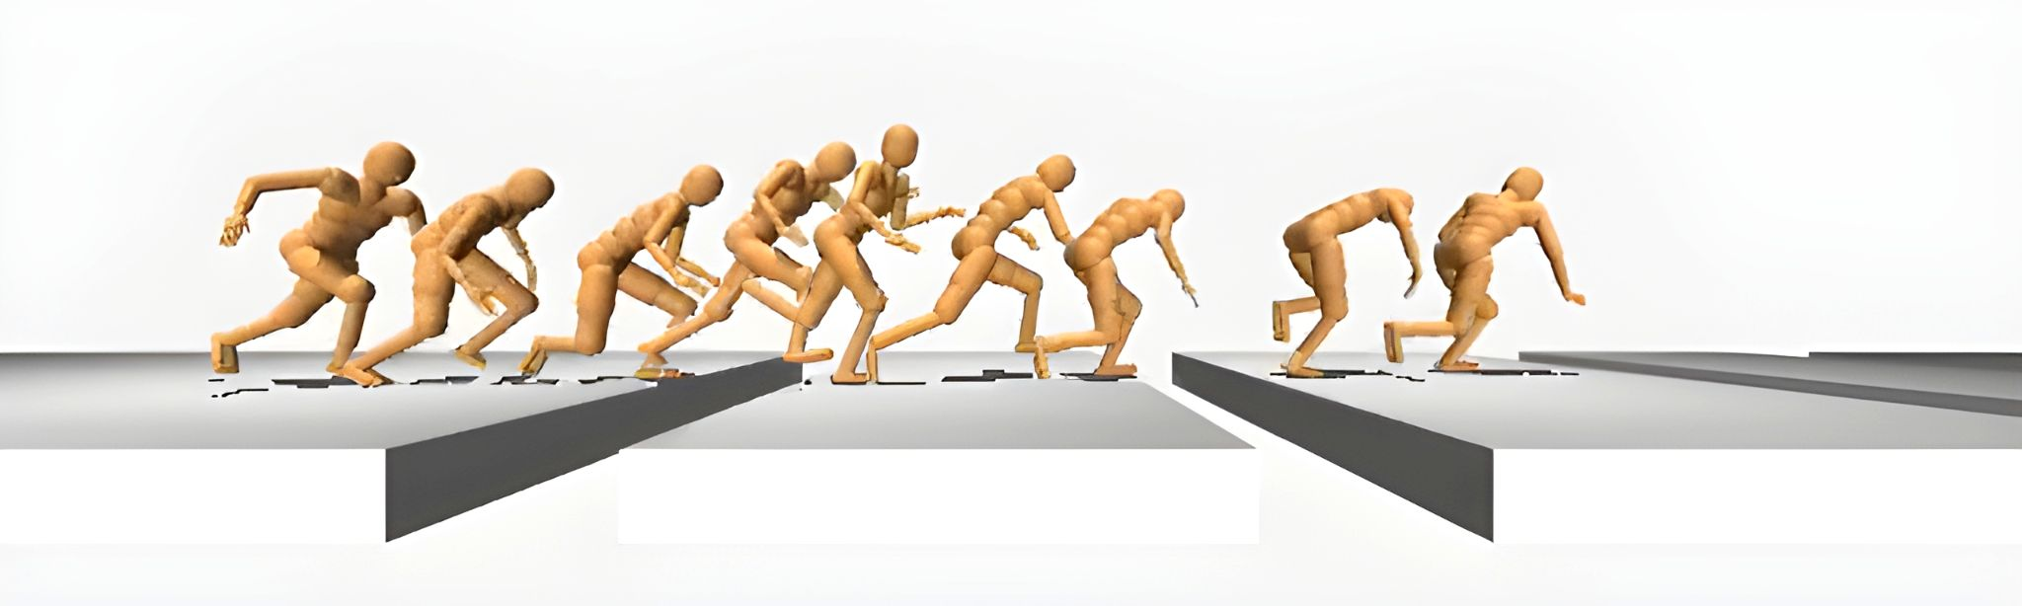
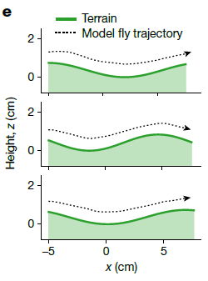
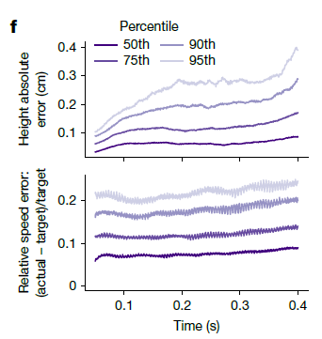
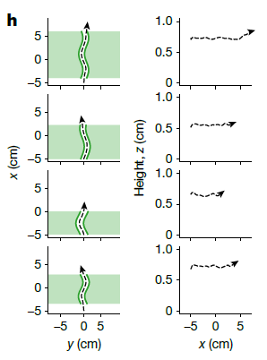
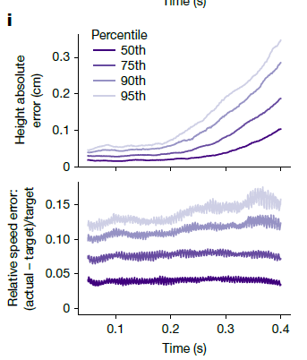
a
Eye camera input
Task input:
Target running speed
Target running direction
b
c
Visual network
(CNN)
Observations:
Proprioception
Vestibular
High-level
controller policy
Steering
command
Pretrained
low-level
controller
Leg
frequency
control
LPG
Human model in MuJoCo
physics simulator
Reward:
Target running speed
Target running direction
Body pitch angle
Centre of sidewalk position
Contact with terrain terminates episode
Actions
Left eye
Right eye
d
Corridor task
g
Notes:
fig_4
Leg Patten Generator (LPG)

